Slide 1
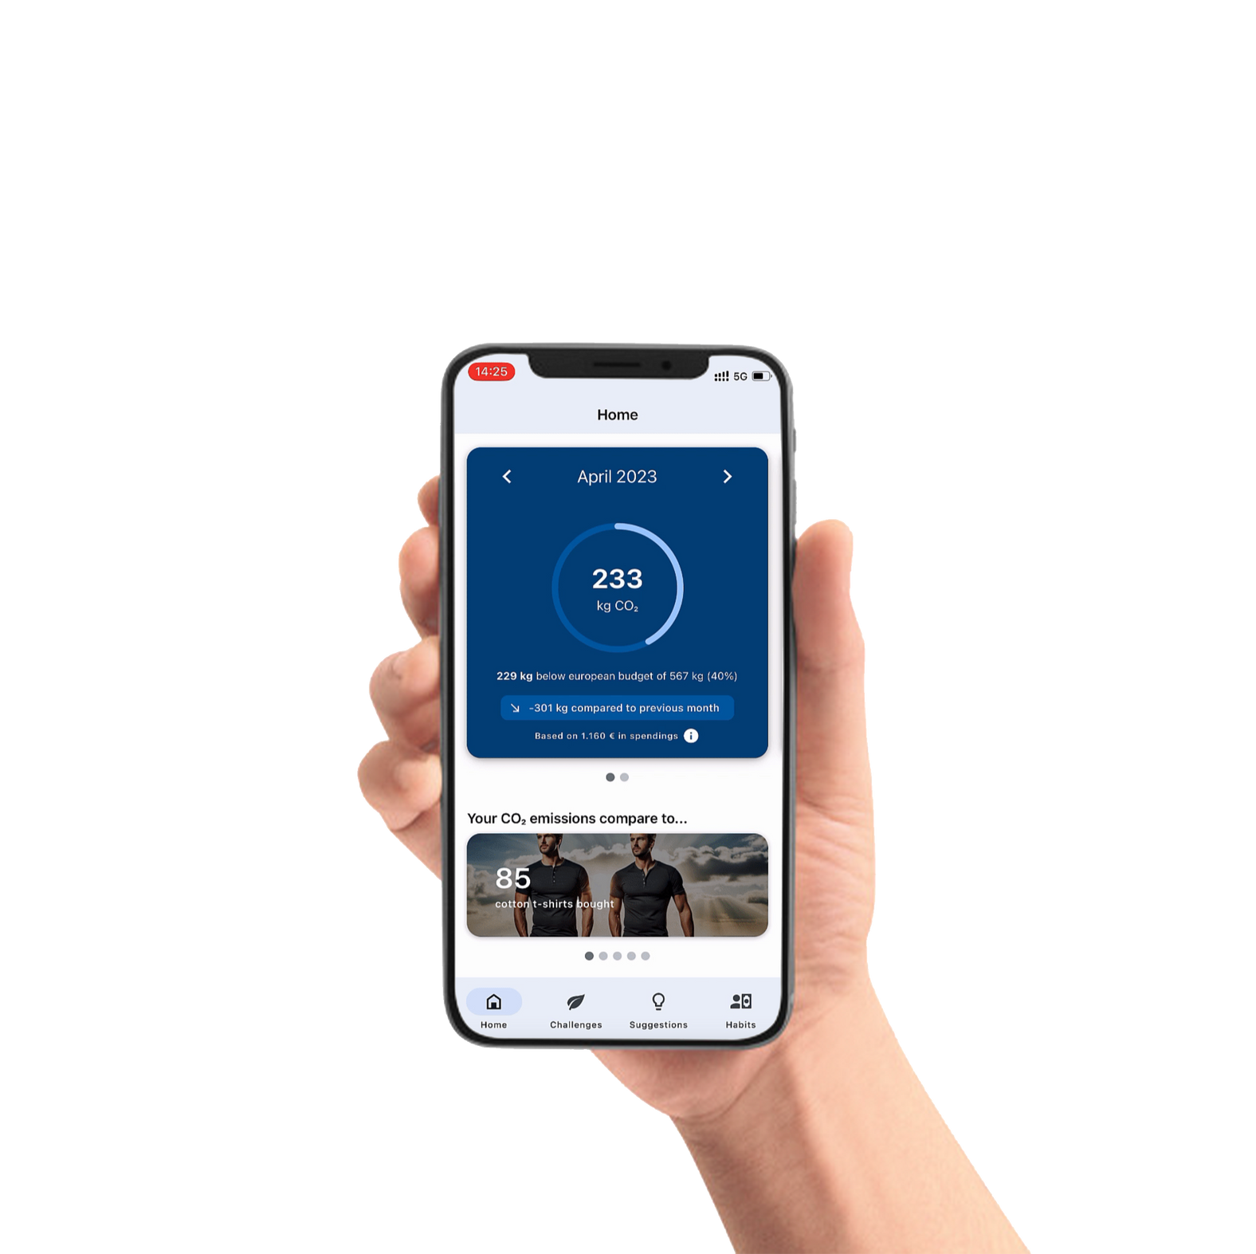


Smart
CO2nverter
CPAD Team 02

Slide 2

Overview
Scenario Introduction
Architecture Solution
Business Value
C4 Model
Features
Demo & Code Overview

Slide 3


Scenario Introduction
In today's world, there is a growing need for individuals to adopt more sustainable behaviors to combat climate change. The challenge is to provide consumers with the tools and insights necessary to understand and reduce their carbon footprint. How might we enable consumers to be more climate conscious while encouraging them to make impactful changes in their daily lives?

Slide 4
What is Smart CO2nverter?
The Smart CO2 Converter is an innovative mobile application designed to empower consumers to understand and reduce their carbon footprint. Built using SAP Cloud Application Programming (CAP) model and React Native on SAP Business Technology Platform (BTP), the app leverages Generative AI via Azure Open AI to provide personalized insights and actionable recommendations. By analyzing users' daily activities and highlighting the most impactful habits, the Smart CO2 Converter guides users towards more sustainable choices, fostering environmental responsibility and promoting a greener lifestyle.

Slide 5

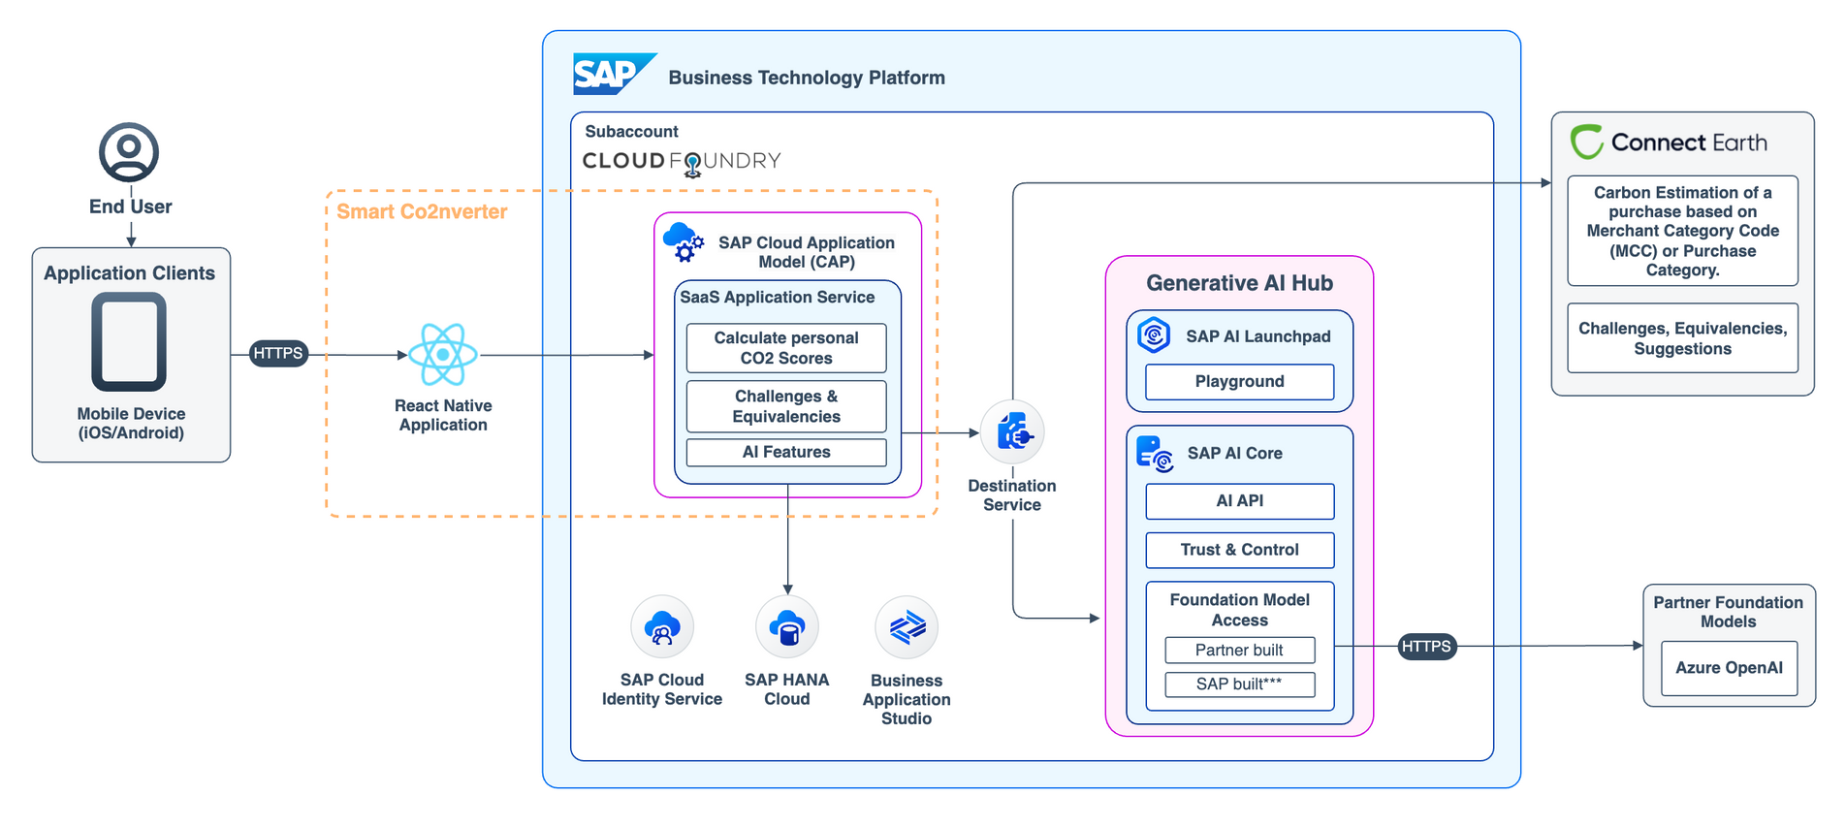
Solution Architecture
Help users understand how their consumption habits are driving their CO2 footprint by showing most impactful expenses and best opportunities for emissions reductions.

Slide 6



Challenge​
How might we enable business customers to be more climate conscious while strengthening their loyalty?​
Solution​
Help users understand how their consumption habits are driving their CO2 footprint by showing the most impactful expenses and best opportunities for emissions reductions.​
Benefits and Value​
A mobile app built using the reusable architecture principles of SAP CAP and React Native on SAP BTP. An application extension using GPT via the Azure OpenAI services that combines business context with the capabilities of large language models on SAP BTP.​
​

Slide 7
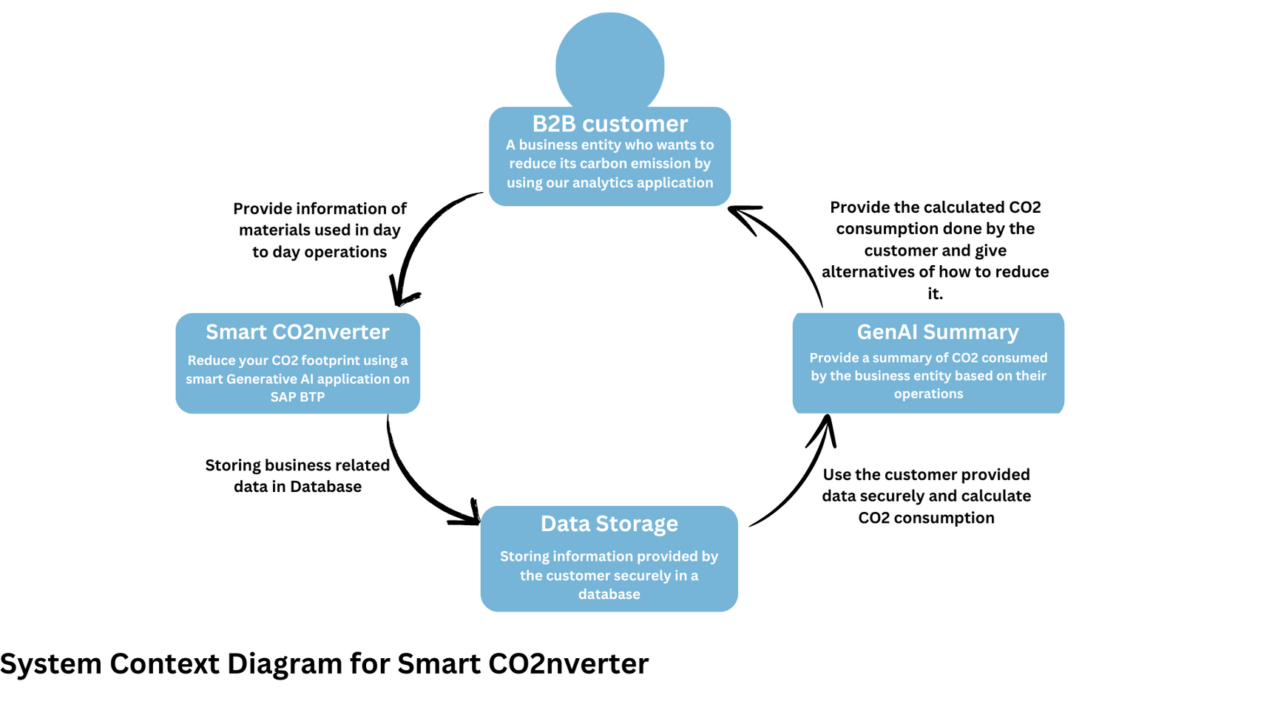
C4 Model
Level-1

Slide 8
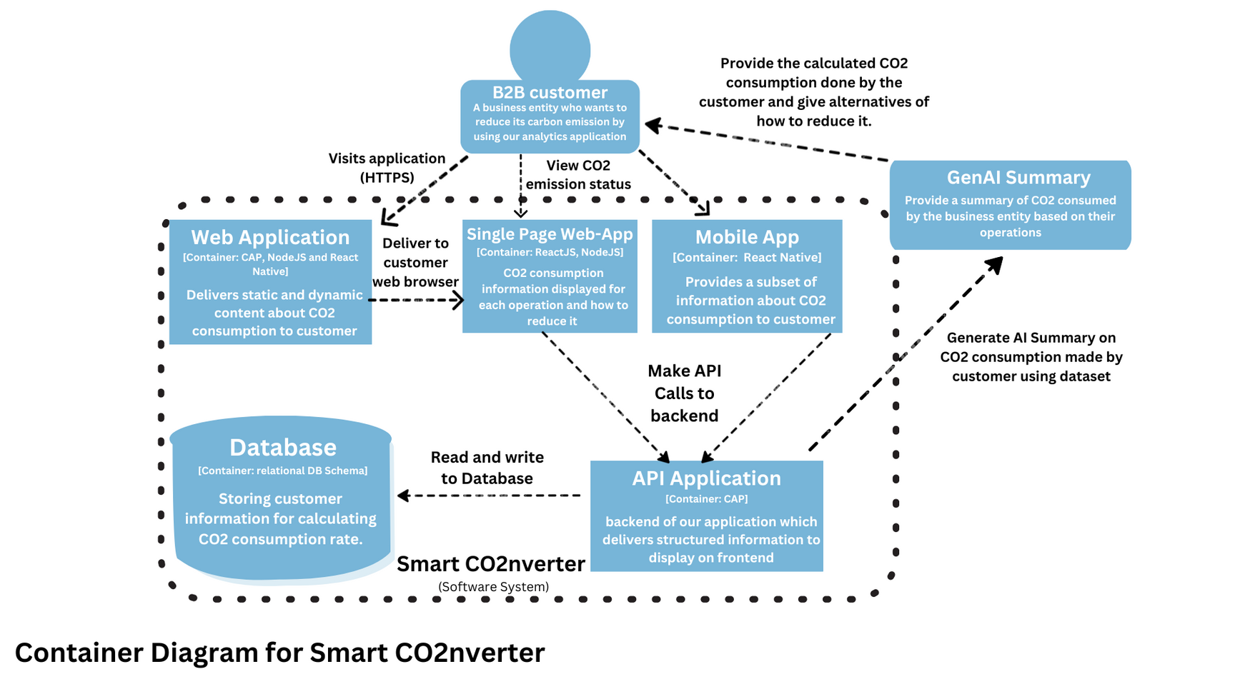
C4 Model
Level-2

Slide 9
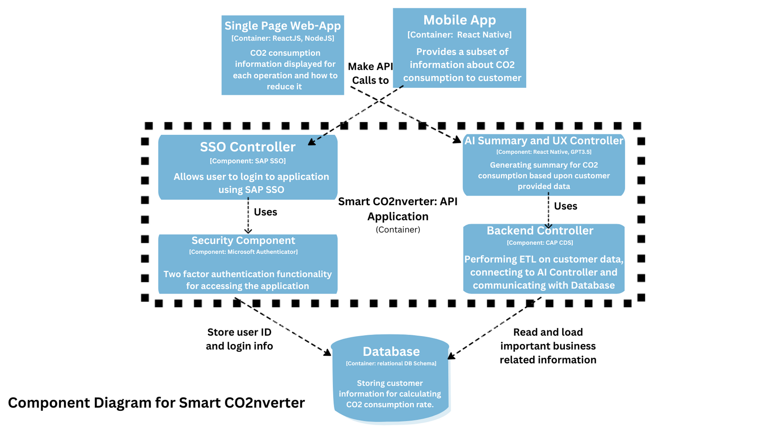
C4 Model
Level-3

Slide 10
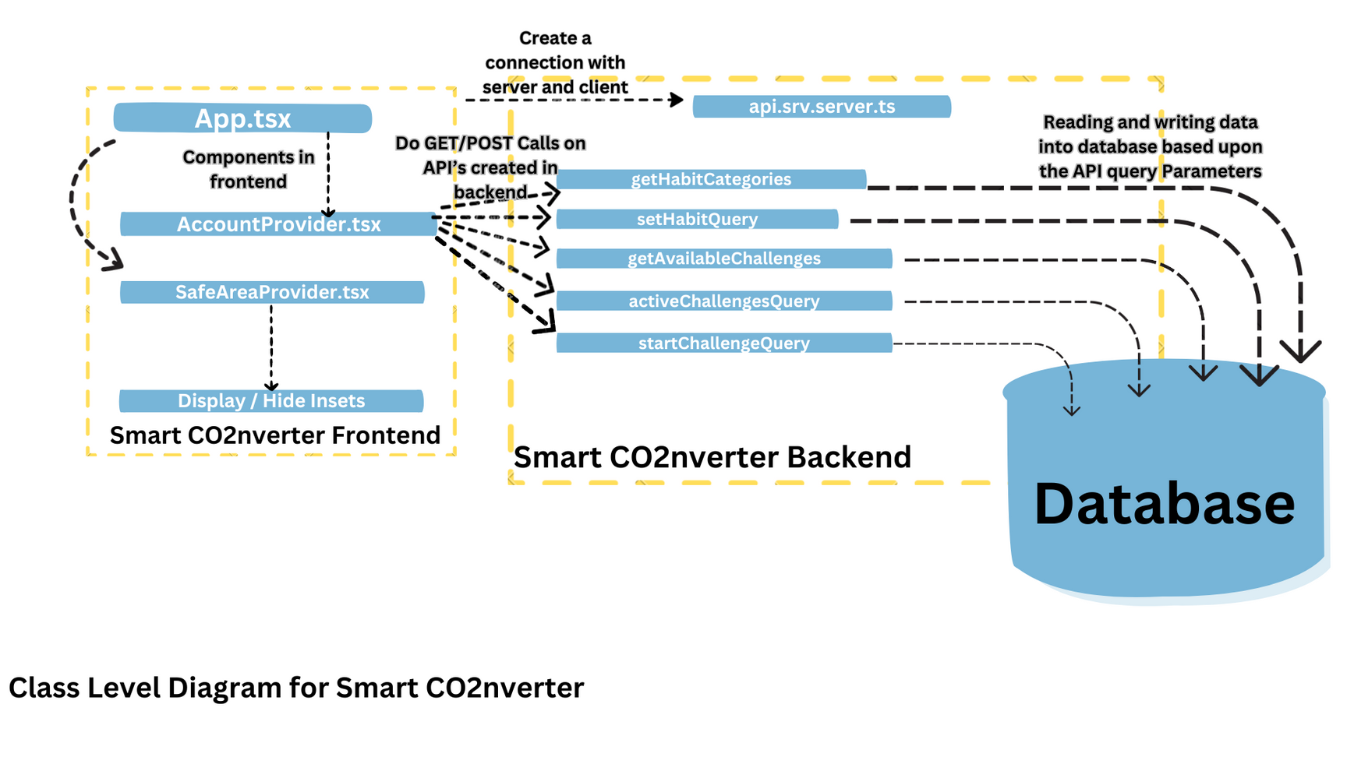
C4 Model
Level-4

Slide 11


Summarization of numerical data​
Features
Recommendations​
Generate suggestions for proper categories​
Generating Emails​
GenAI Features & Insights​
Benefits of Challenges
/Spending Habits
Generating insights and instructions
Categorization of Transactions​
Synthethic Data Setup​
Categories​
Determining Factors for different habits​
Generating Equivalencies and related images​

Slide 12
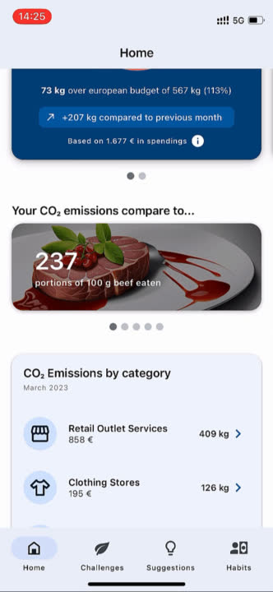
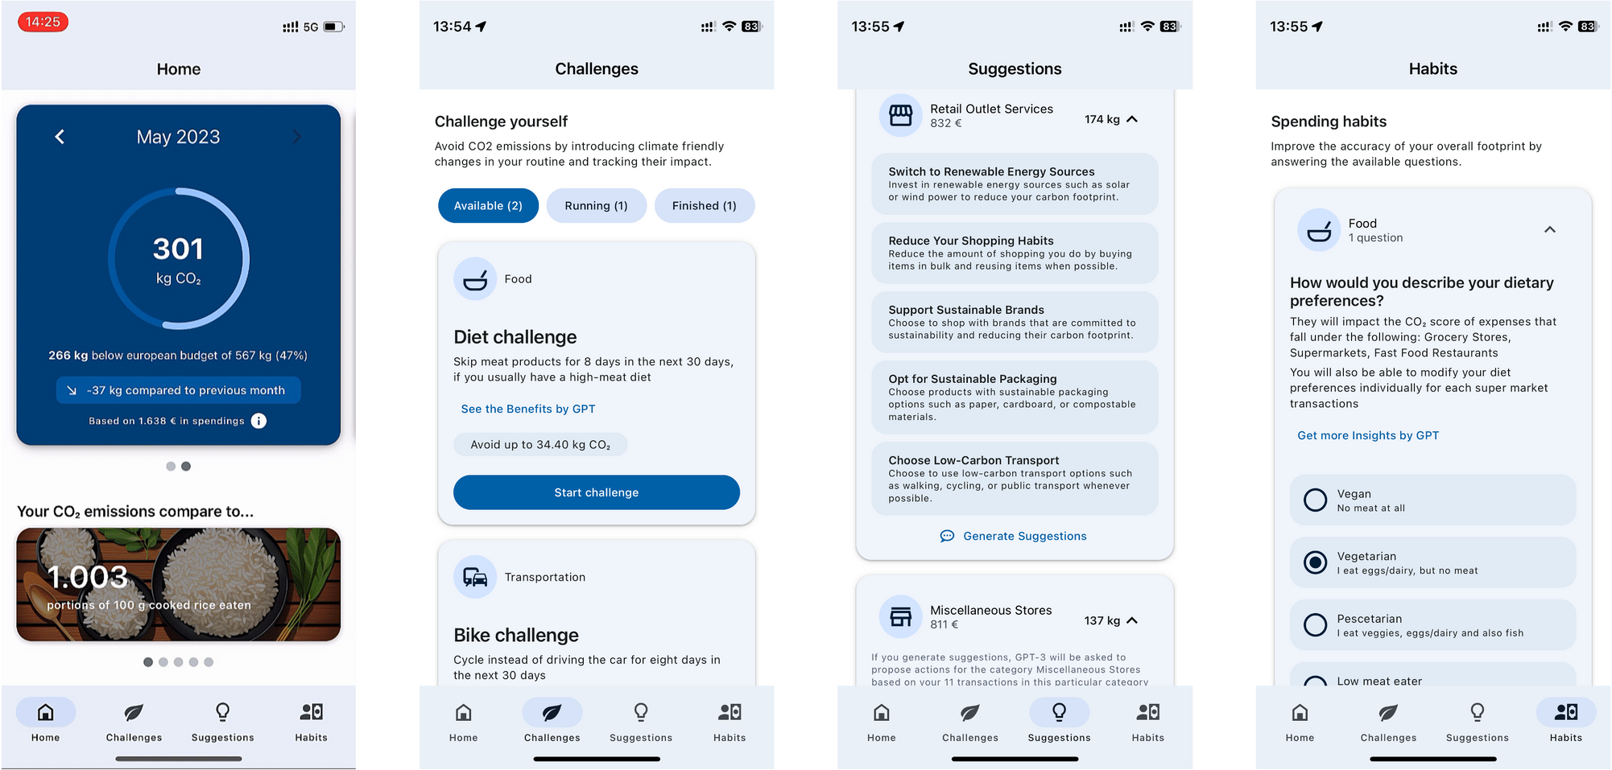
In-App Screens

Slide 13


Demo and
Code Review

Slide 14








Our Team
Ayush Behl
Navya Khurana
Sudhit Jain
Kartik Kapoor
2021hs70013
2021hs70014
2021hs70038
2021hs70005

